Slide 1
Remotely Observing Reverse Engineers to Evaluate Software Protection
By Claire Taylor
Committee Members:
Christian Collberg, chair
Kate Isaacs, member
Saumya Debray, member
Carlos Scheidegger, member

Slide 2

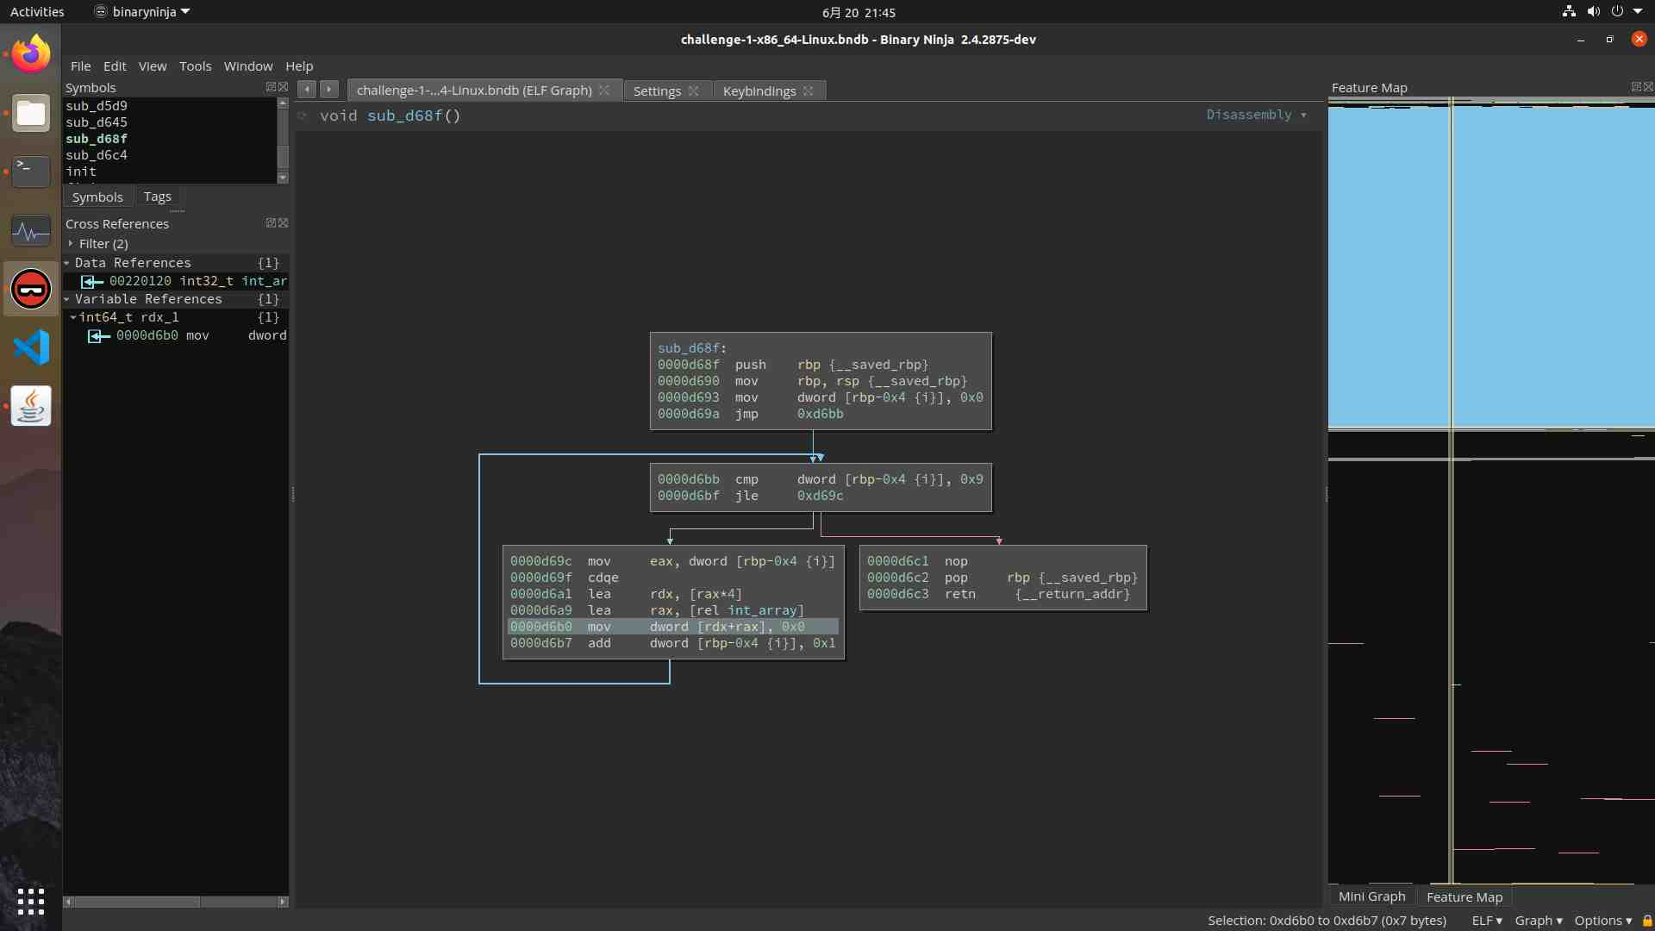

Man-At-The-End Scenario
Program
Defense:
Create a program
Include one or more sensitive assets:
Encryption keys
Passwords
Intellectual property
Distribute program
Attacker:
Obtain program
Extract asset
Asset
Password = “12345”
SQL = “SELECT *…”

Slide 3
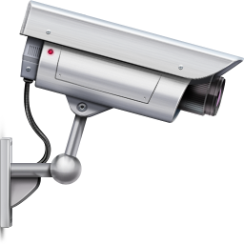
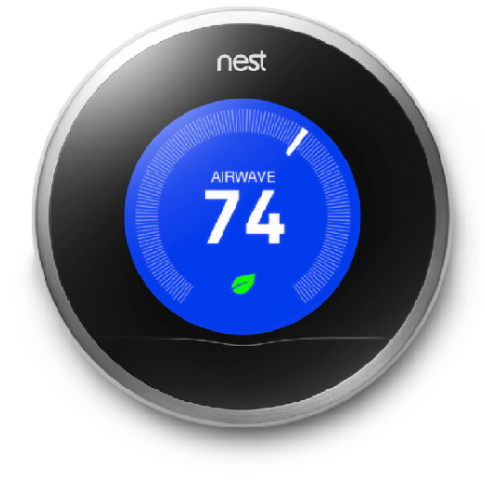
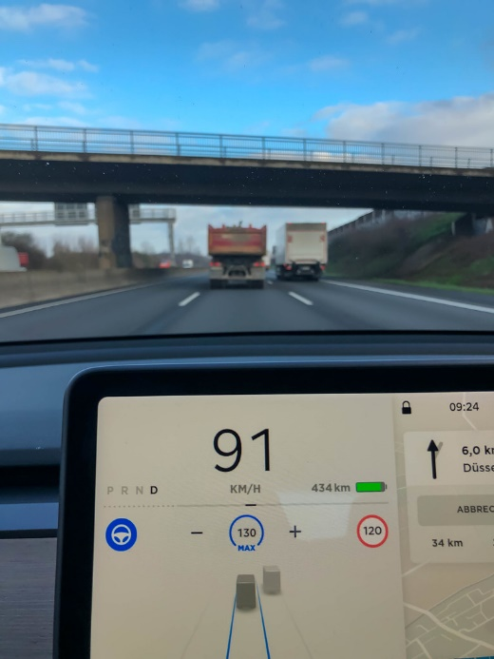
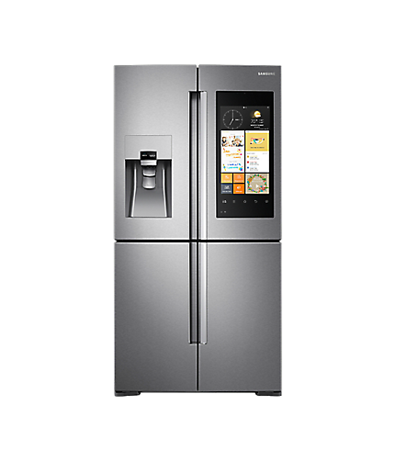



Attack Goals
Extract
Credentials
Copy
Intellectual
Property
Tamper to
Cause Harm
Notes:
IoT devices, by definition, are often susceptible to MATE attacks:
they are typically under the control of their owners
They are susceptible to many of the same attacks we’ve seen already
someone might want to extract intellectual property embedded within these devices,
or someone may want to tamper with them to cause harm, in this case a medical device.
or since these devices often have credentials embedded in their firmware, someone might want to reverse engineer and get hold of these credentials.

Slide 4

Obfuscation vs. Reverse Engineering
Compromised
Too Slow
Original
Protected
Protected
Obfuscate
Distribute
Obfuscate

Slide 5
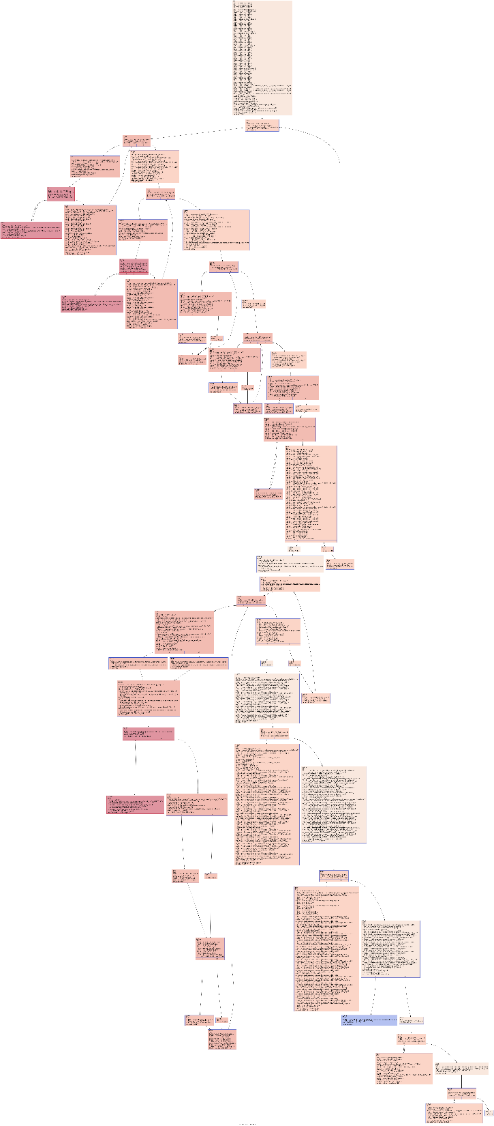
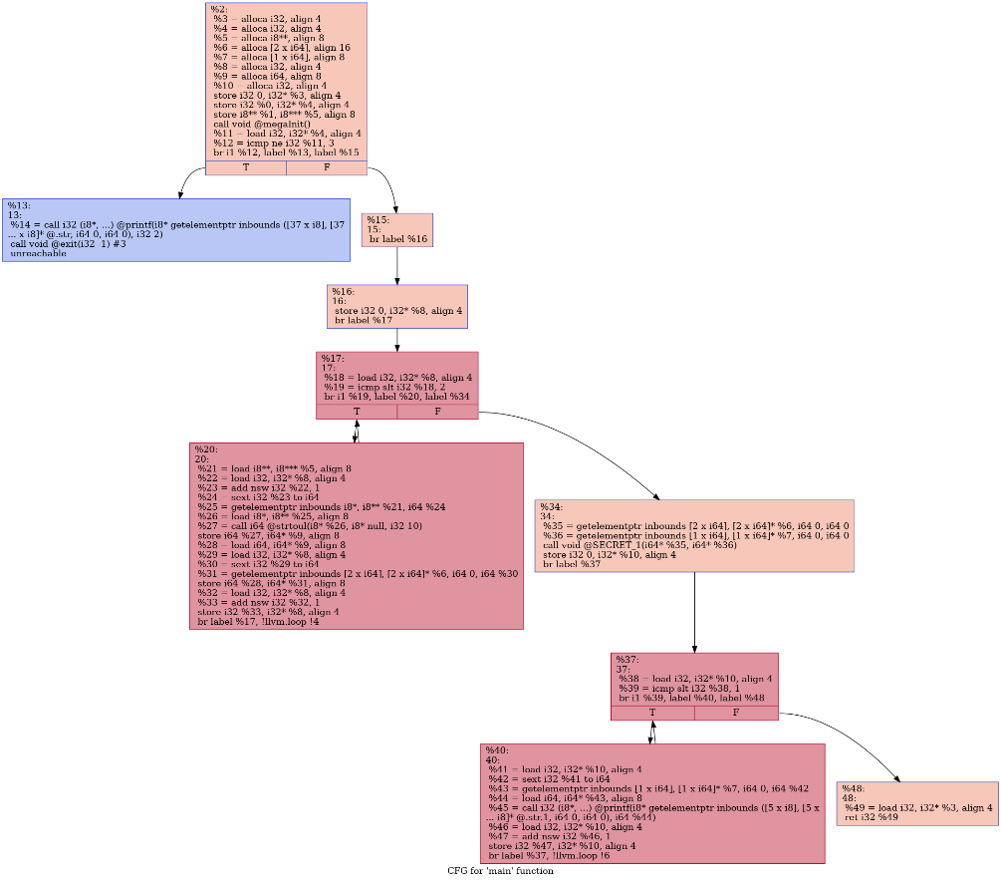
Obfuscation – Tools and Techniques
Opaque Predicates
Flattening
Virtualization
Self Modifying
Many, many more…
Transforms are combined to withstand different types of attack

Slide 6






Reverse Engineering – Tools and Techniques
Types of RE
Static
Disassemble
Control flow graphs
Dynamic
Debug
Fuzzing
Hybrid
Symbolic
Concolic
REs use a combination of manual and automated attack methods

Slide 7
Evaluating Protections and Attacks

Slide 8
How Well Does Obfuscation Work?
How well does it prevent reverse engineers from accomplishing their goals?
How long?
Key
Original
Protected
Obfuscate
Cracked
Source Code
Reverse engineering hinges on human expertise and intuition
Evaluating this is difficult

Slide 9
Choosing Obfuscating Transformations Wisely
Estimated
Lifetime
In the Wild
Original
Protected
Obfuscate
Distribute
Protect
(Strength, Performance)

Slide 10
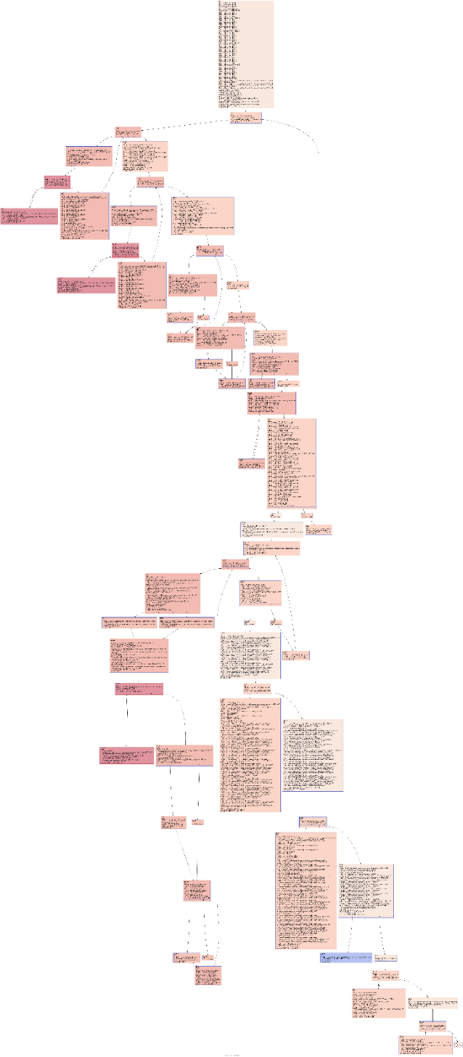
Software Complexity Metrics
Instruction counts
Cyclomatic numbers
Knot counts
Many many more…
Designed to measure complexity of programs during development
Simple!
Unclear if they measure difficulty of attack
42
4200

Slide 11
Studies of Students
Measure how well students complete RE tasks
Ceccato et al.
Masters and PhD students given RE task
Easy to find lots of subjects
Unclear if results apply to real attackers
Cannot ask students to attack “real” protections

Slide 12
Studies of Professional Reverse Engineers
Observed challenges:
Ceccato et al. and Votipka et al.
Relies on interviews
Models of RE behavior
Gets general data from experts
Experts hesitant to disclose detailed techniques
Unobserved challenges:
WhibOx
All whitebox schemes broken
ASPIRE
Subjects solved 5 of 8
Tests real-world protection techniques
RE techniques are not examined or recorded

Slide 13

Performance of Current Tools
Original
Protected
Obfuscate
Attack with tools T₁, T₂, T_{x}!
Broken!
Too slow!
Evaluates the state of the art (of public tools)
Tools could be easily tweaked, limited to known tools

Slide 14
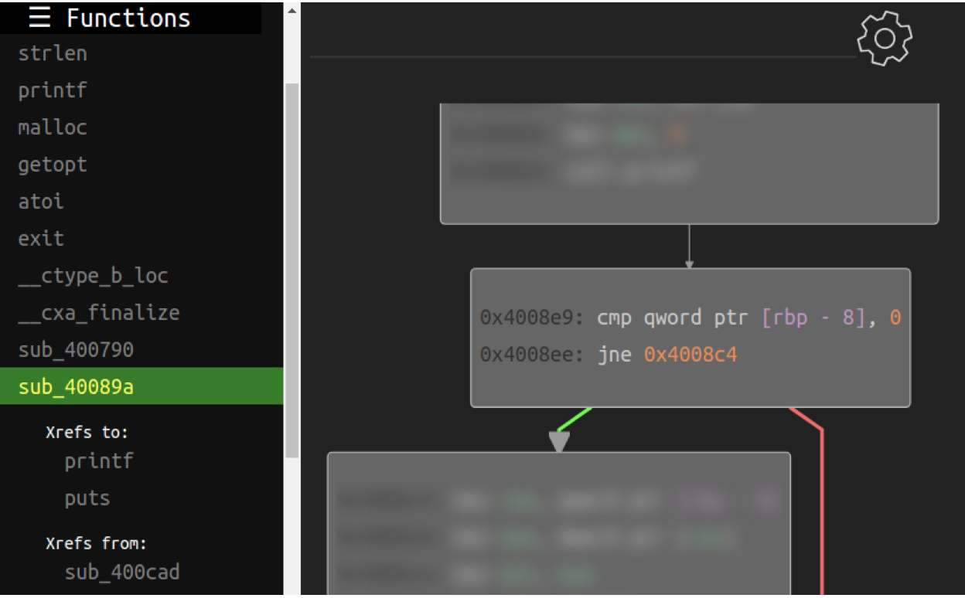
Monitoring Study (USENIX 2022)
Mantovani et al. (forthcoming)
Used a web-based RE tool with UI
Built to imitate typical RE tools
Provisioned with monitoring tools
Monitored users disassembling a binary
Recorded RE strategies in detail
Got significant # of subjects (72)
Very specific
REs can only use given tool
Only tests RE of disassembly
Does not evaluate obfuscation

Slide 15

Academic Obfuscation Evaluation
Invent new obfuscation
Invent evaluation method
Peer Review
Evaluation not convincing
<include tigress>
for(node n in P)
for(inst in n)
switch(inst.type):
case branch:
Defeats disassembler X
Code size increase
Difficult to analyze because…
Cannot compare algorithms from different papers
Lack of standard evaluation methods slows down progress in the field

Slide 16
This work: Remotely Monitored Human Studies

Slide 17
Main Idea
Generate representative reverse engineering challenges
Entice professional REs to solve them anywhere in the world
Monitor them remotely, collecting highly detailed data
Build models from the collected data
We gather real world reverse engineering data
Fine grained data enables many different analyses
Can be used with any challenge type
Subjects can use the tools and environments they like
Lots of issues!

Slide 18

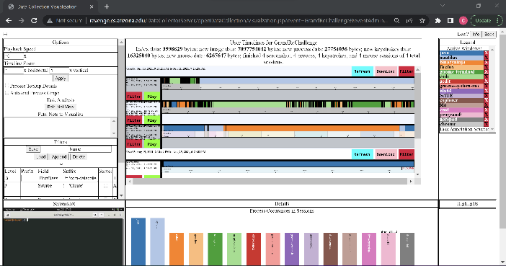
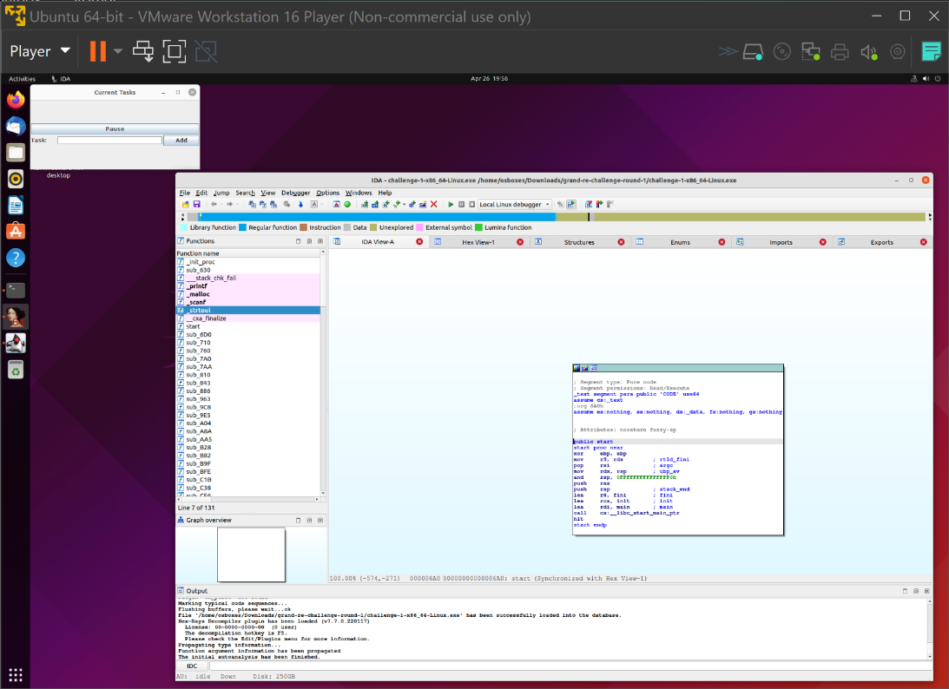
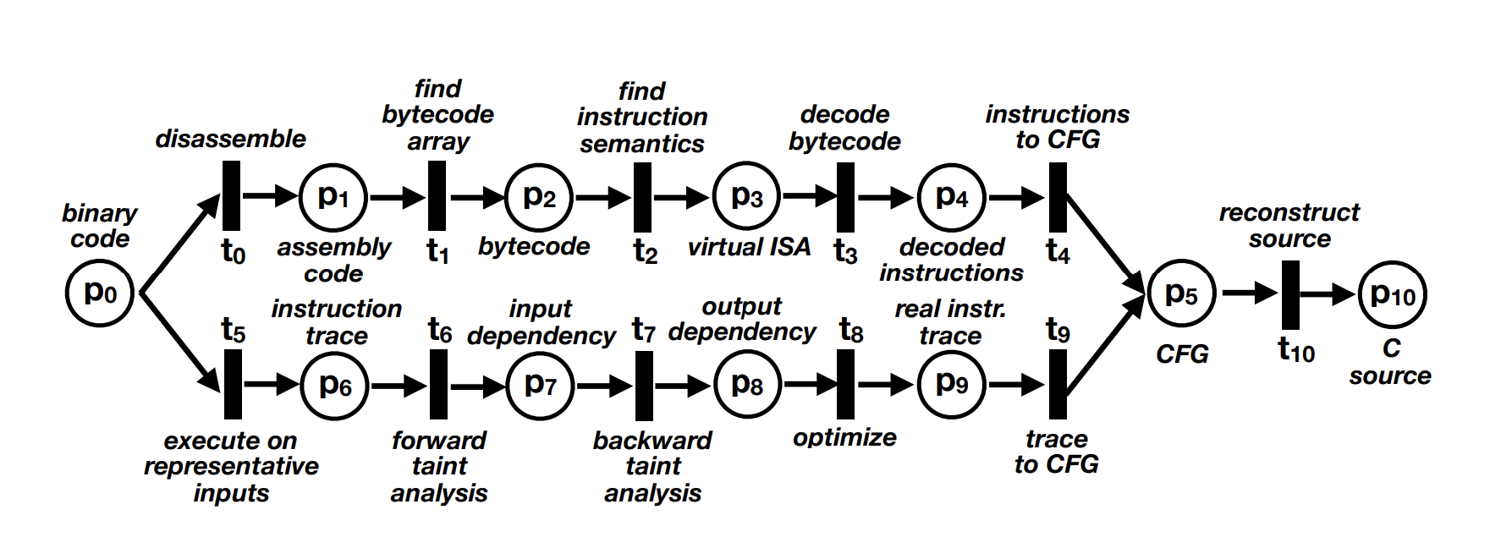
Random
Program
Protected
Challenge
RE Event
PAY $$s!
Announce competition
Protect
Attack!
Analyze Collected Data
Build
Model
Our endpoint monitor

Slide 19
Random
Program
Protected
Challenge
Protect
RQ3: Will generated synthetic reverse engineering challenges capture real-world reverse engineering tasks?

Slide 20
Random
Program
Protected
Challenge
PAY $$s!
Announce competition
Protect
Attack!
RQ2: What type of incentives are needed to recruit a significant number of expert reverse engineers to participate in these studies?

Slide 21
Random
Program
Protected
Challenge
PAY $$s!
Announce competition
Protect
Attack!
RQ1: Is it possible to build a system to remotely and unobtrusively collect high fidelity human-device interaction (HDI) data from experts in their own heterogeneous computing environments as they reverse engineer software?
Our endpoint monitor

Slide 22
Random
Program
Protected
Challenge
PAY $$s!
Announce competition
Protect
Attack!
Analyze Collected Data
Our endpoint monitor
RQ4: Can the resulting datasets be lifted to human-understandable models of subjects’ behavior?

Slide 23
Random
Program
Protected
Challenge
PAY $$s!
Announce competition
Protect
Attack!
RQ5: Do these analyses and models provide valuable insight into reverse engineering practices and code obfuscation efficacy?
Build
Model
Our endpoint monitor

Slide 24
Results
A research team and I hosted four reverse engineering events
I gathered human-device-interaction data in these events
The events contained 117 sign-ups and 44 participants
3 participants solved challenges
We paid out $8500 total
We paid $68/hour of active trace

Slide 25
Results…
The data is highly granular (mouse clicks, key presses, window data, process data, screenshots)
To do all of this, I built:
A data collection tool to monitor users
A visualization tool that allows analysts to annotate the raw data
A modeling tool that builds models of RE behavior from annotations
Ghent University used these tools for a student-based study

Slide 26
Challenge Generation
Random
Program
Protected
Challenge
Protect

Slide 27
Challenge Types
Extract This Asset
Parallel real world problems
Types:
Extraction
Tampering
Deobfuscation
Disable This Protection
call branchFun();
asm(”.byte 42,2,6”);
. . .
L:
Decompile and Deobfuscate
goto L;
. . .
L:

Slide 28
Tools
Tigress (Arizona)
Generates random programs with random assets
Source to source obfuscator
ASPIRE (Ghent)
Link-time obfuscator
Hand-coded challenges
Irdeto
Commercial tool
Hand-coded challenges
We do not really know what they did…

Slide 29
Issues
Challenges too hard → no data
Successful subjects spent about 8 hours on each submission
Most challenges went unsolved
Challenges too easy → no interesting data
Random challenges → will not mimic real applications
Hand-coded challenges → subjects will learn over time

Slide 30
Recruiting Subjects
RE Event
Announce competition
PAY $$s!
30

Slide 31
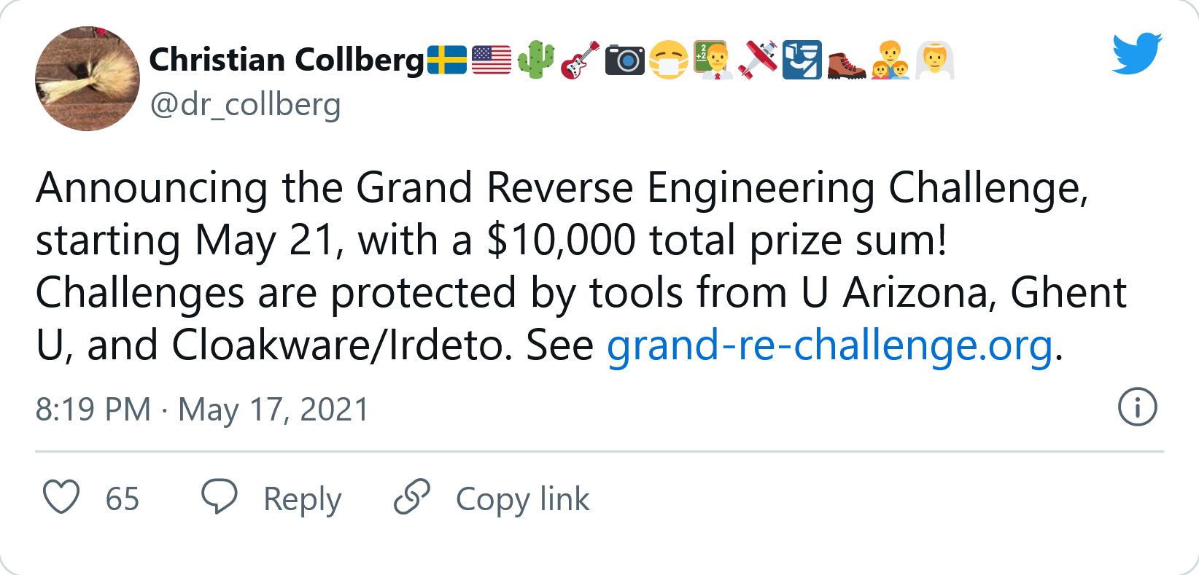
Promoting Events
Social media
Personal and department accounts
Twitter
Instagram
Facebook (including groups)
Reddit
Hacker News
Email lists
Course announcements

Slide 32
Participant Compensation
Two main models:
$100-$500 per problem
Resulted in 1 subject submitting 3 solutions
$1000-$10,000 per event winner
Resulted in 2 subjects submitting 7 solutions
Total of 96 registrations and 39 participants

Slide 33
Issues
Need usable funding (lots!)
How to pay subjects (large amounts!):
In foreign countries
Who do not want to give their banking details!
Too high compensation → novice subjects will avoid
Too low compensation → accomplished subjects will avoid

Slide 34
Collecting Data
Our endpoint monitor

Slide 35


VM
Install
Endpoint
Monitor
Download
Challenges
Install RE
Tools
35

Slide 36
Endpoint Monitor
Gathers data from subjects’ devices
Collected data:
Key input
Mouse input
Process data
Active windows
Screenshots

Slide 37
Requirements
Must support all major OS/hardware.
Rolf Rolles: Would love to help but I will only work on Windows
Must run in VM or bare hardware:
Low-power ARM devices like RPI
Performance
CPU, Memory, Persistence, Network
Some subjects have less powerful devices

Slide 38
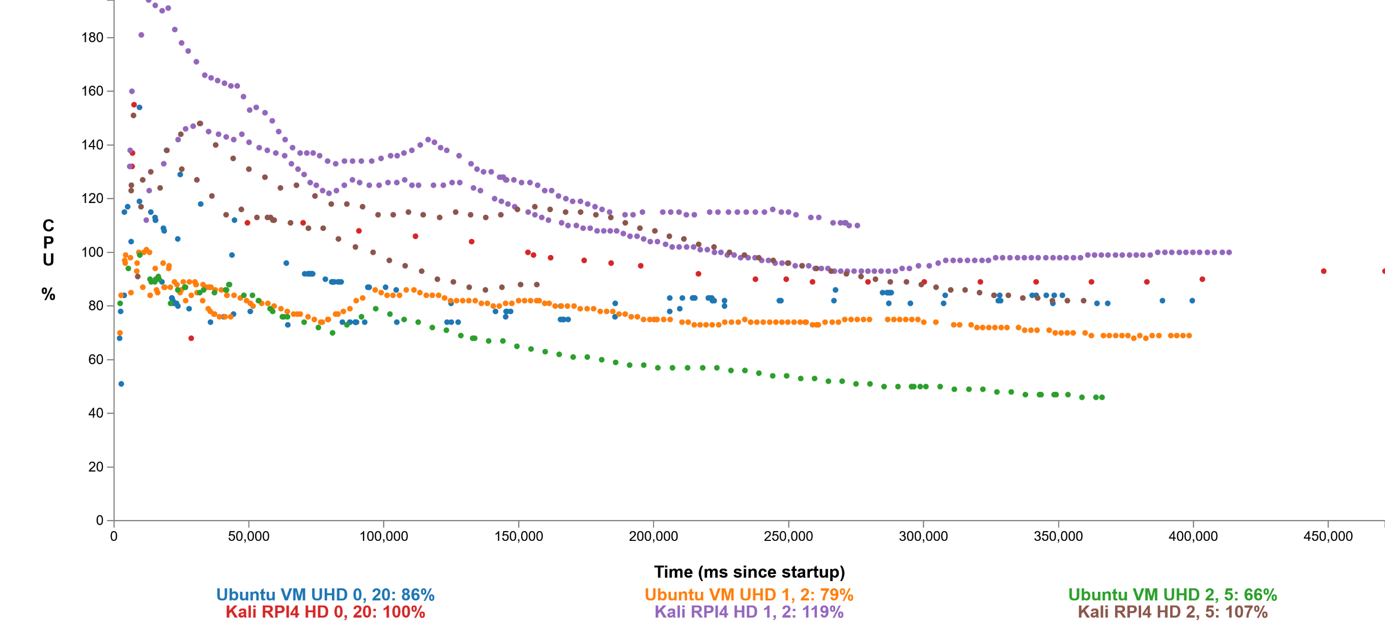
Performance
Uses 60-100% of a x86 VM core;
Uses 100-120% of native ARM core
2.4 (x86 VM) and 1.2 (ARM) screenshot FPS

Slide 39
Analyzing and Annotating Data
Analyze Collected Data

Slide 40
Analysis Process
User data is too granular to build models from
First: Human analysis lifts the data to annotations manually
Analyze Collected Data
Our endpoint monitor

Slide 41
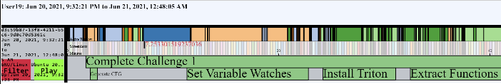
What do Annotations Describe?
Action: What a subject does
Goal: The result of the action
Success: Whether the action succeeded in accomplishing the goal
Notes: High level understanding
Tags: Standardized details

Slide 42
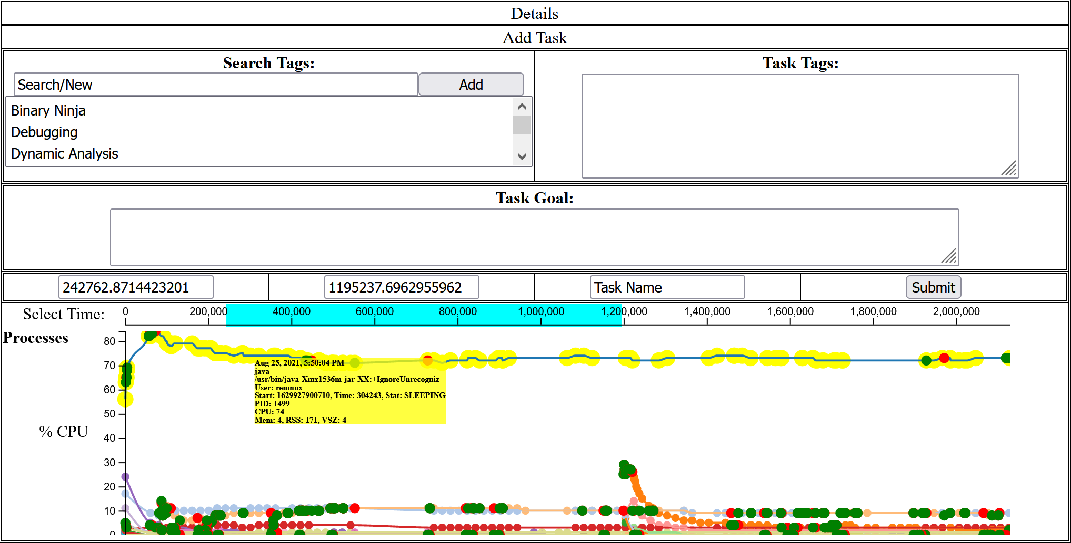
Process Graph View

Slide 43
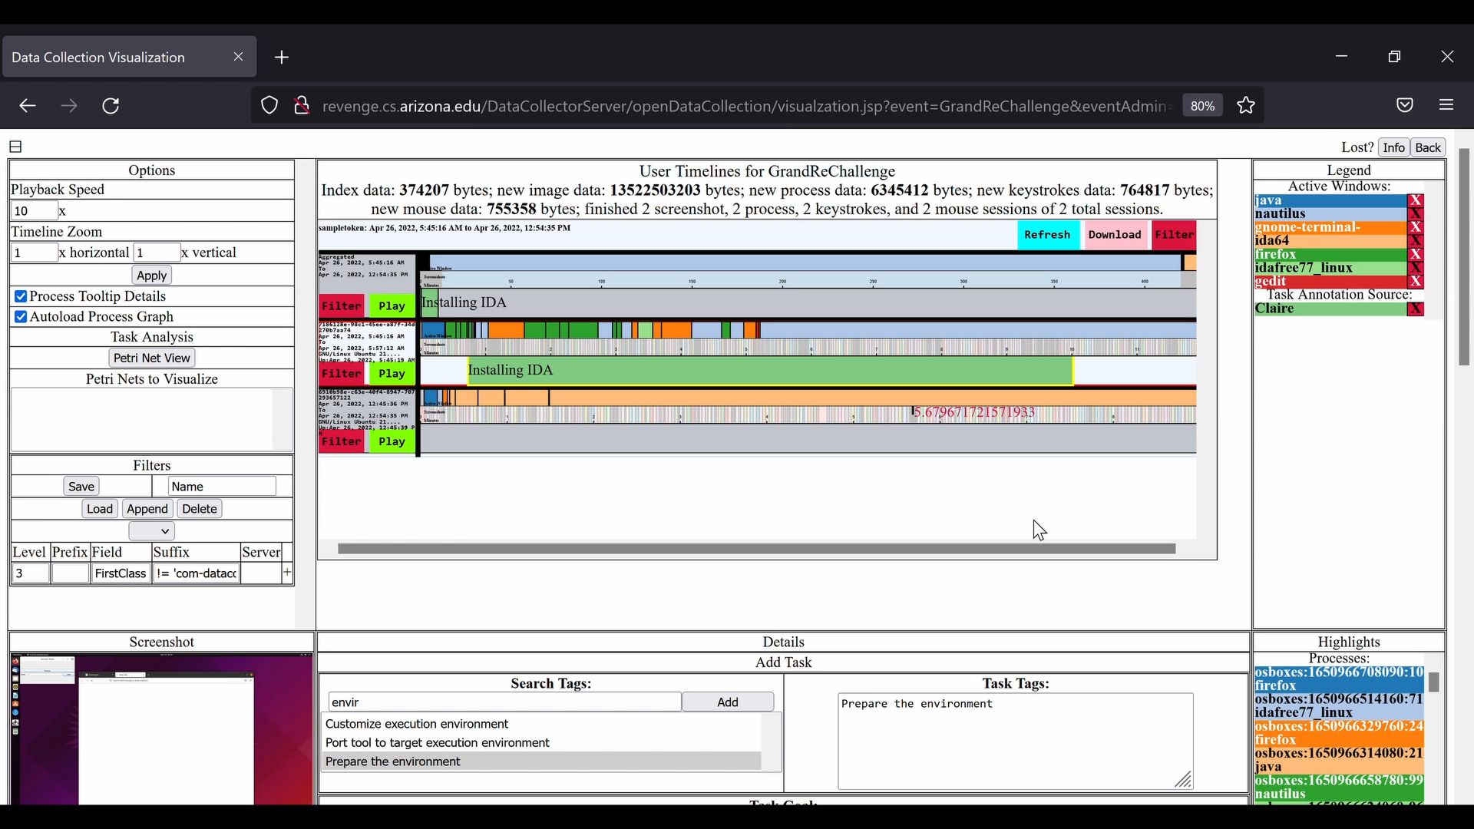

Slide 44
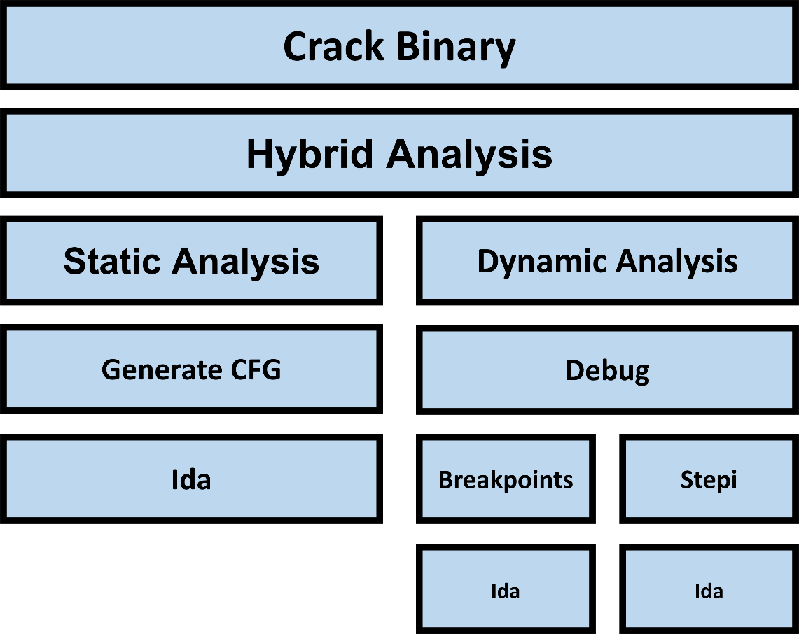
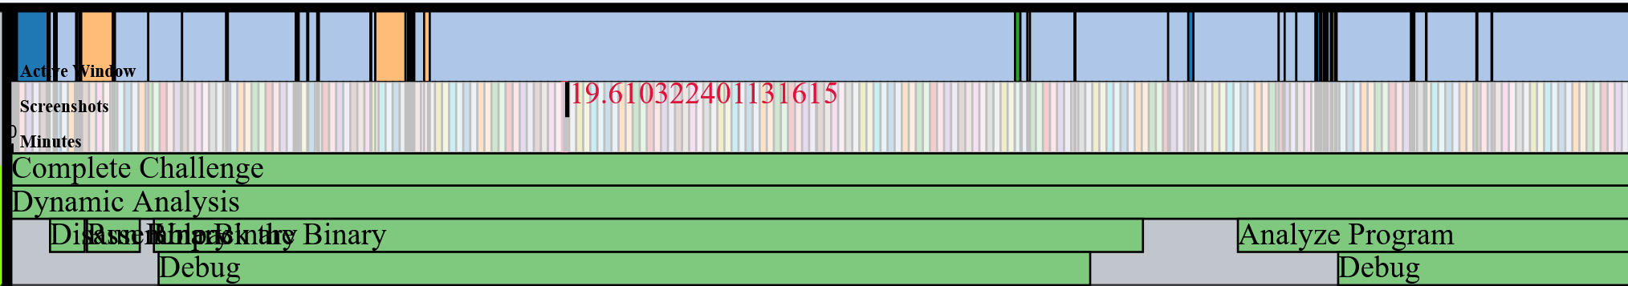
Outcome – “Gantt Chart” of Annotations

Slide 45
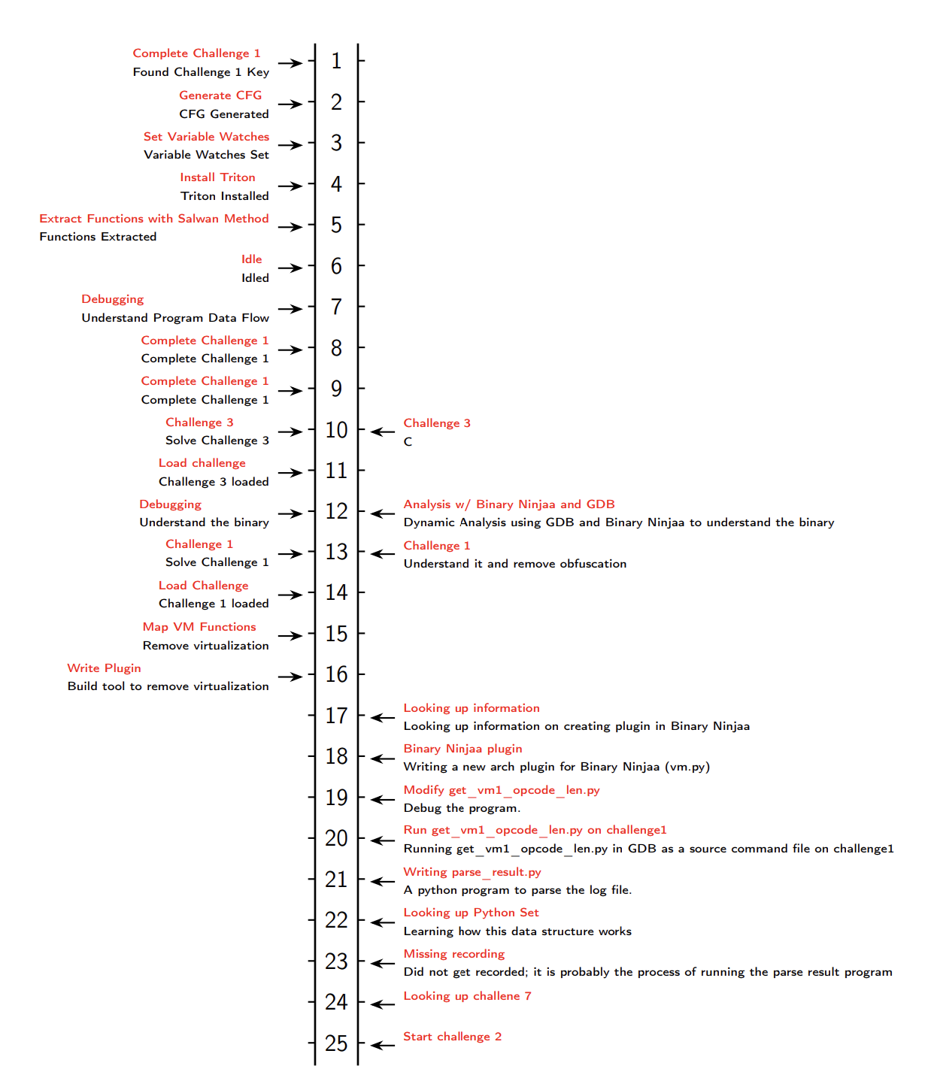
Annotation Variance
Two annotators on the same data set produced significantly different results
Annotation detail levels
Annotation structure differences

Slide 46
Issues
Different analysts will annotate differently:
Levels of specificity
How to nest annotations
Annotation rates:
Currently, we have 110 hours of traces ☺
Annotation is roughly real-time ☹
Differences in annotation lead to differences in models

Slide 47
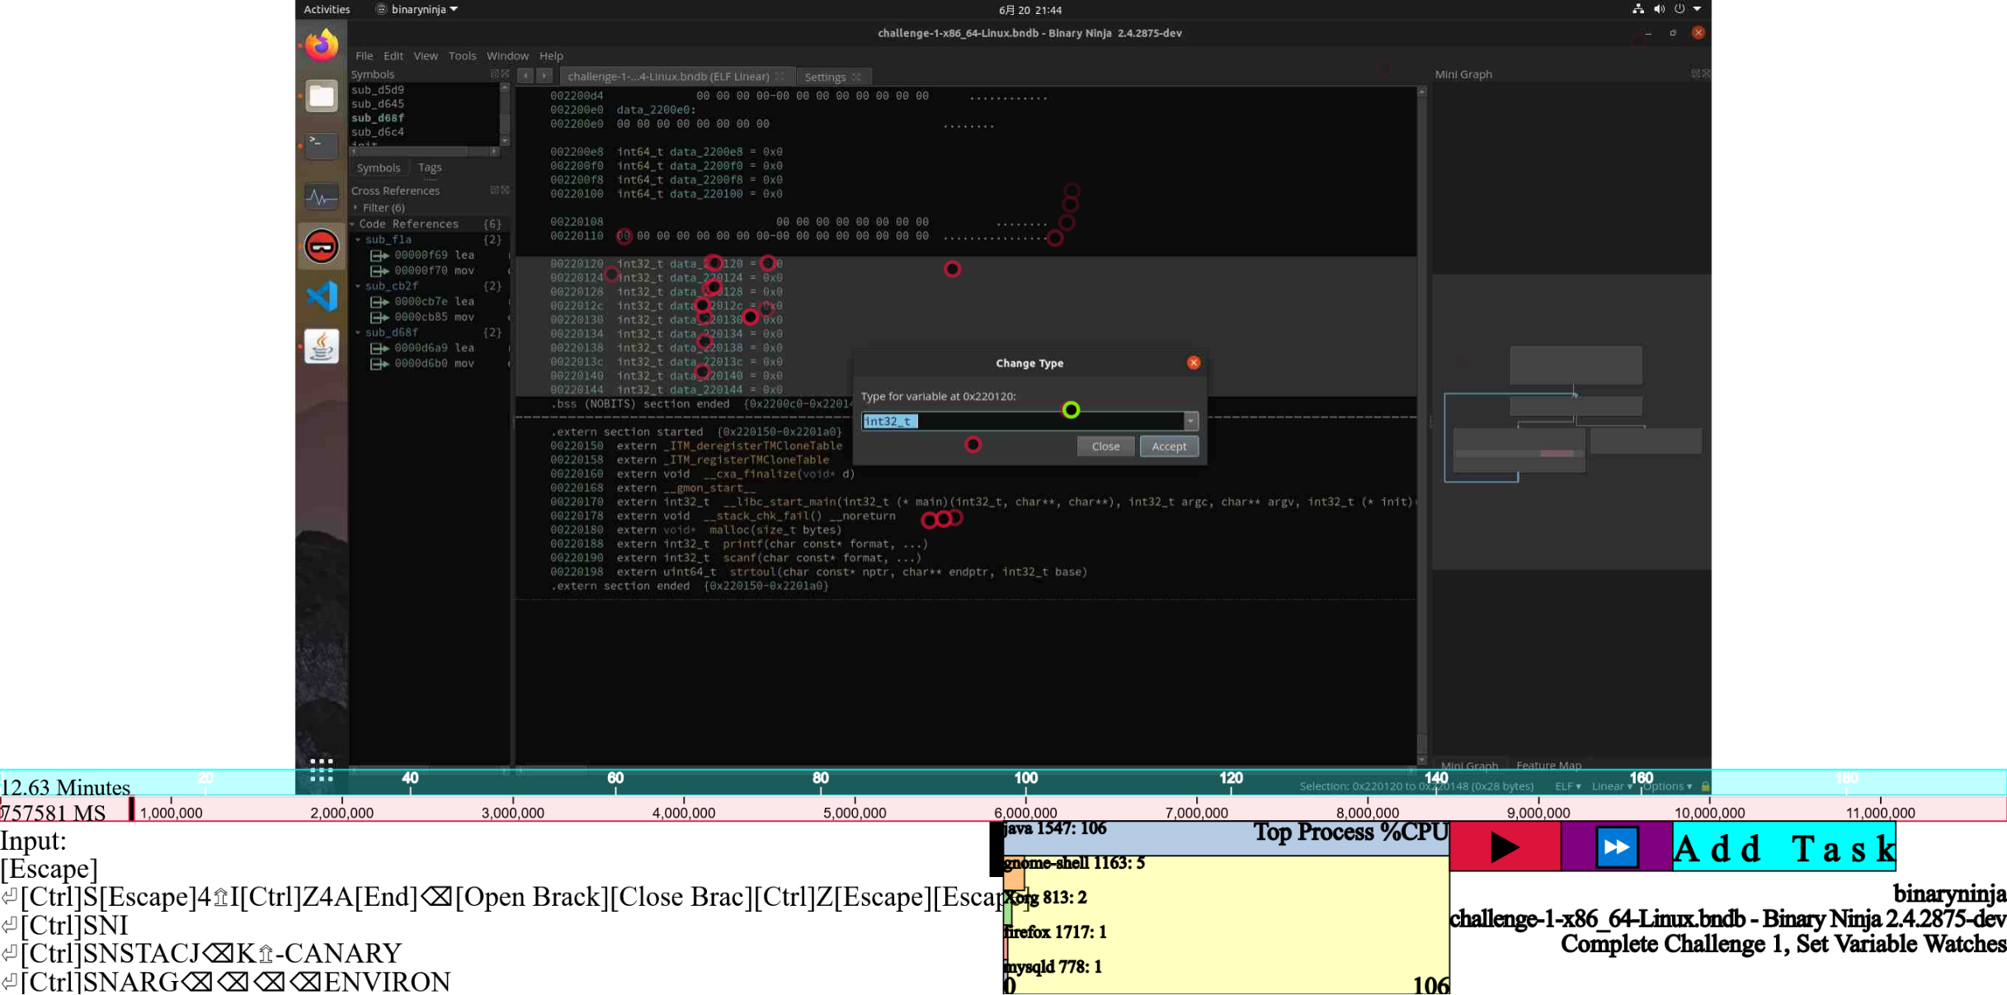
Future Work: Faster Annotation
Auto UI
modeling
Auto
segmentation
Auto text
classification

Slide 48
From Annotations to Models

Slide 49

Modeling Process
The annotation step manually labels underlying data
The next step derives a model from the annotations

Slide 50

Building Models
Types of models used in prior work
Attack trees
Attack graphs
Petri nets
Petri net overview
Model asynchronous behavior
Consist of places and transitions
These model states and actions
Edges between places and transitions
Input State
Action
Output State
Input State
Action
Output State

Slide 51
Example
Manual Devirtualization (Rolf Rolles)
Automatic Devirtualization (Yadegari)

Slide 52
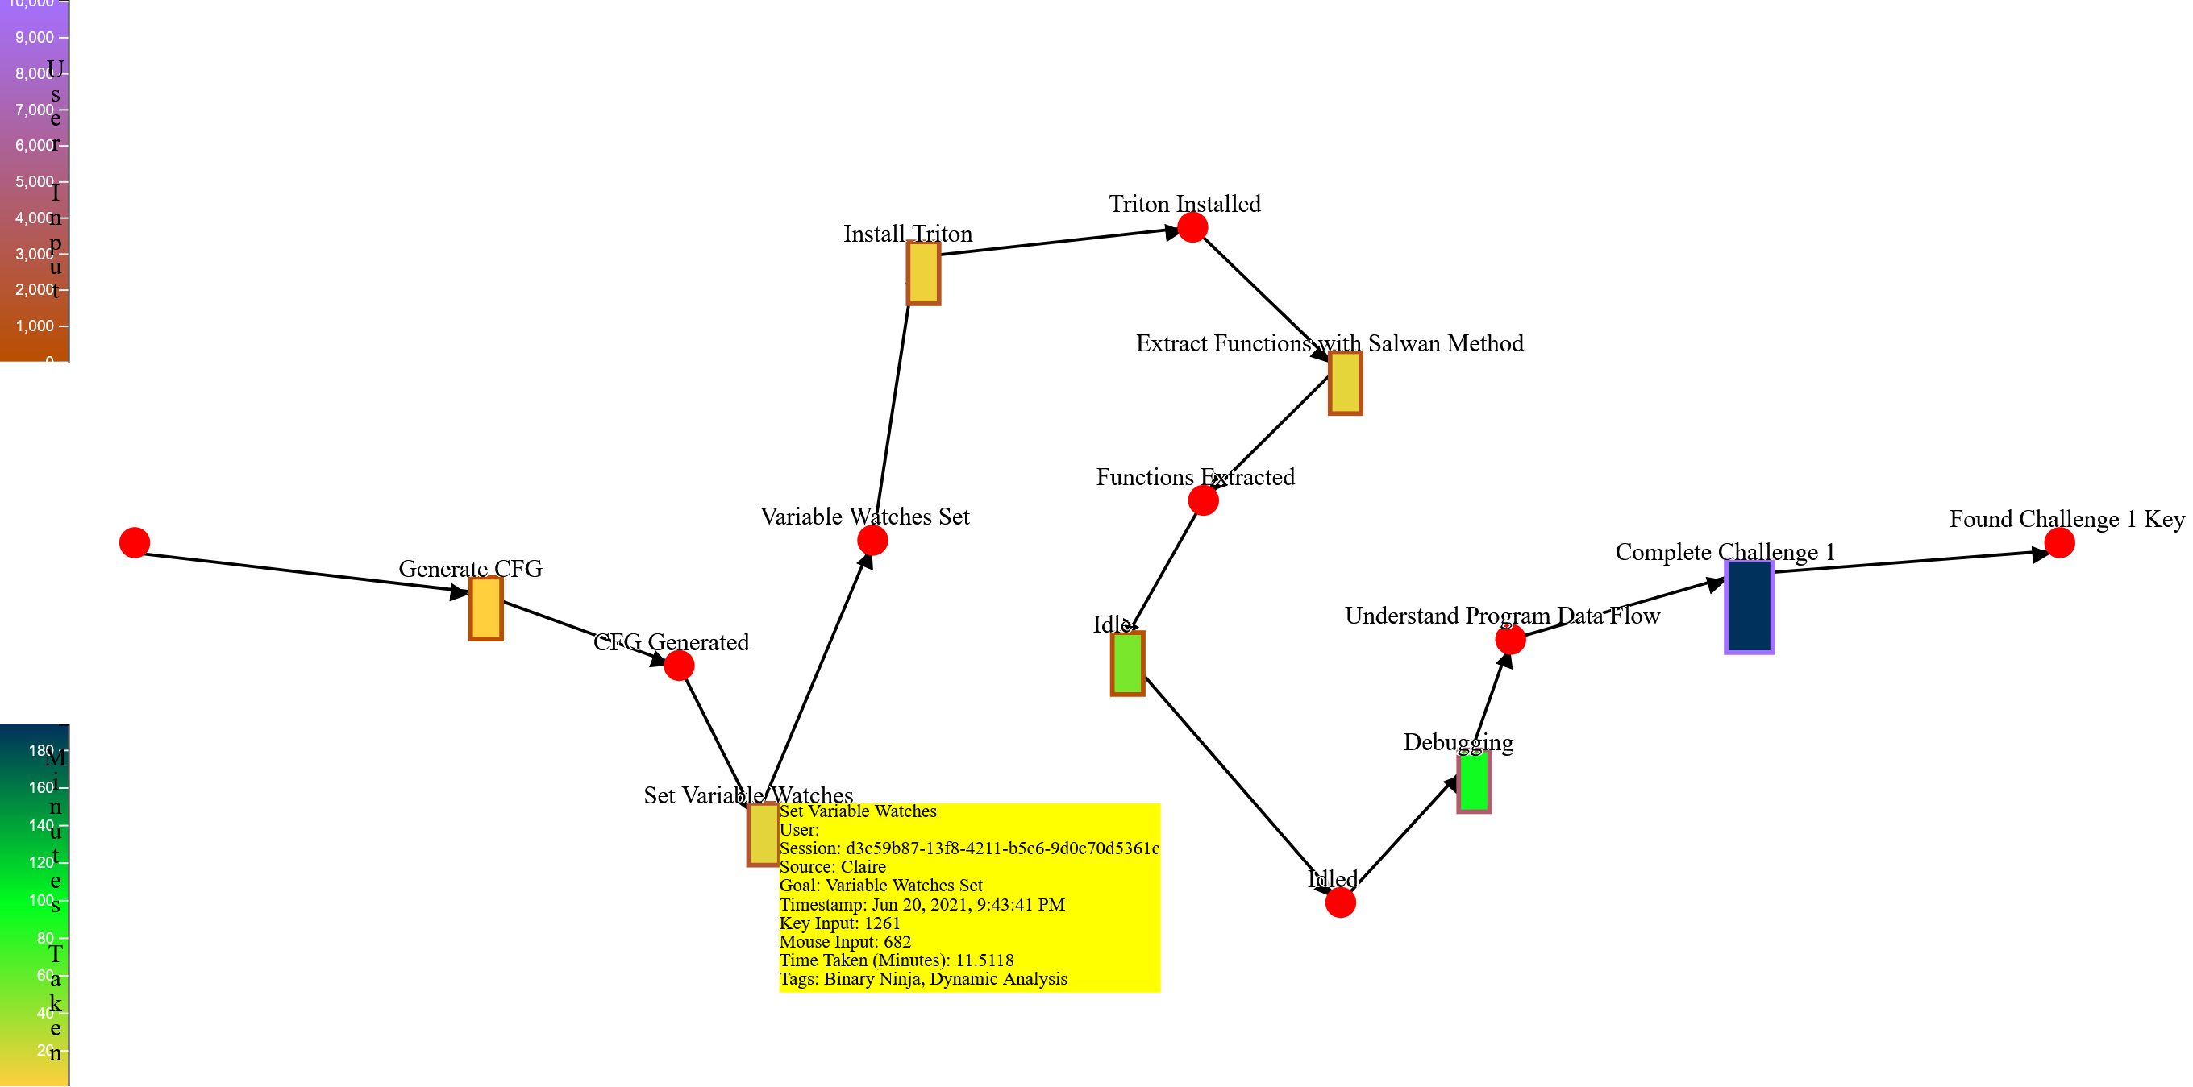
Generated Petri Net

Slide 53
Building Models From Annotations
Task 1, Goal 1
Task 1
[Goal 1]

Slide 54
Annotation Relationships

Slide 55
Example
Task 1: Parent
Task 2: Child
Task 3: Child
Task 4: Child
Task 2
[2]
Task 3
[2, 3]
Task 1
[2, 3, 4, 1]
Task 4
[4]

Slide 56
Issues
Bad annotations → bad models
Correlation does not imply causation
Inconsistent annotations → bad models
Future work: (post-event) validation of models through subject interviews
Future work: merging models from multiple subjects

Slide 57

Results

Slide 58
Random
Program
Protected
Challenge
Protect
RQ3: Will generated synthetic reverse engineering challenges capture real-world reverse engineering tasks?
Irdeto’s tools are the #1 in the field.
Tigress has also been used commercially.
Future work: generation of reasonable random programs.
Future work: survey subjects and tool vendors.

Slide 59
PAY $$s!
Announce competition
Attack!
RQ2: What type of incentives are needed to recruit a significant number of expert reverse engineer to participate in these studies?
$7000 in prizes got us
96 sign ups
39 users installed data collection (77 total devices)
2 subjects solved a total of 7 challenges
$68 per hour of active trace
Finding subjects is hard:
Do not want to share proprietary methods?
Challenges are time consuming
Security folks have privacy concerns

Slide 60
RQ1: Is it possible to build a system to remotely and unobtrusively collect high fidelity HDI data from experts in their own heterogeneous computing environments as they reverse engineer software?
Attack!
Endpoint monitor uses 60-120% of a CPU core
Data points:
66907 windows
16602159 processes
116285 screenshots
111393 mouse input
379064 keyboard input
26 GiB of data collected
Our endpoint monitor

Slide 61
Analyze Collected Data
RQ4: Can the resulting datasets be lifted to human-understandable models of subjects’ behavior?
Initial annotations suggest analysts can observe RE methods
Consistent annotation is hard
Manual annotation is slow (real time)
Future work:
More automation is necessary
Annotation validation
Our endpoint monitor

Slide 62
RQ5: Do these analyses and models provide valuable insight into reverse engineering practices and code obfuscation efficacy?
Ultimately: we do not know
We do see…
Typical, known methods and tools in the data and visualization
How long it takes to solve challenges with different tools
Future work:
Validating generated models through subject interviews

Slide 63
Acknowledgements
I would like to thank my dissertation committee: Kate Isaacs, Saumya Debray, Carlos Scheidegger, and particularly my advisor Christian Collberg, as well as the department and the graduate coordinator Tina Mendoza.
I would also like to thank the entire Grand Reverse Engineering Challenge research team: Bjorn De Sutter, Bart Coppens, Bert Abrath, Tab Zhang, and Jens Van Den Broeck, from Ghent University, , Waleed Mebane from University of Arizona, Phil Eisen and Catherine Chambers from Cloakware/Irdeto.
Supported by NSF grants 1145913 and 2040206.

Slide 64
Questions?

Slide 65
Extras

Slide 66
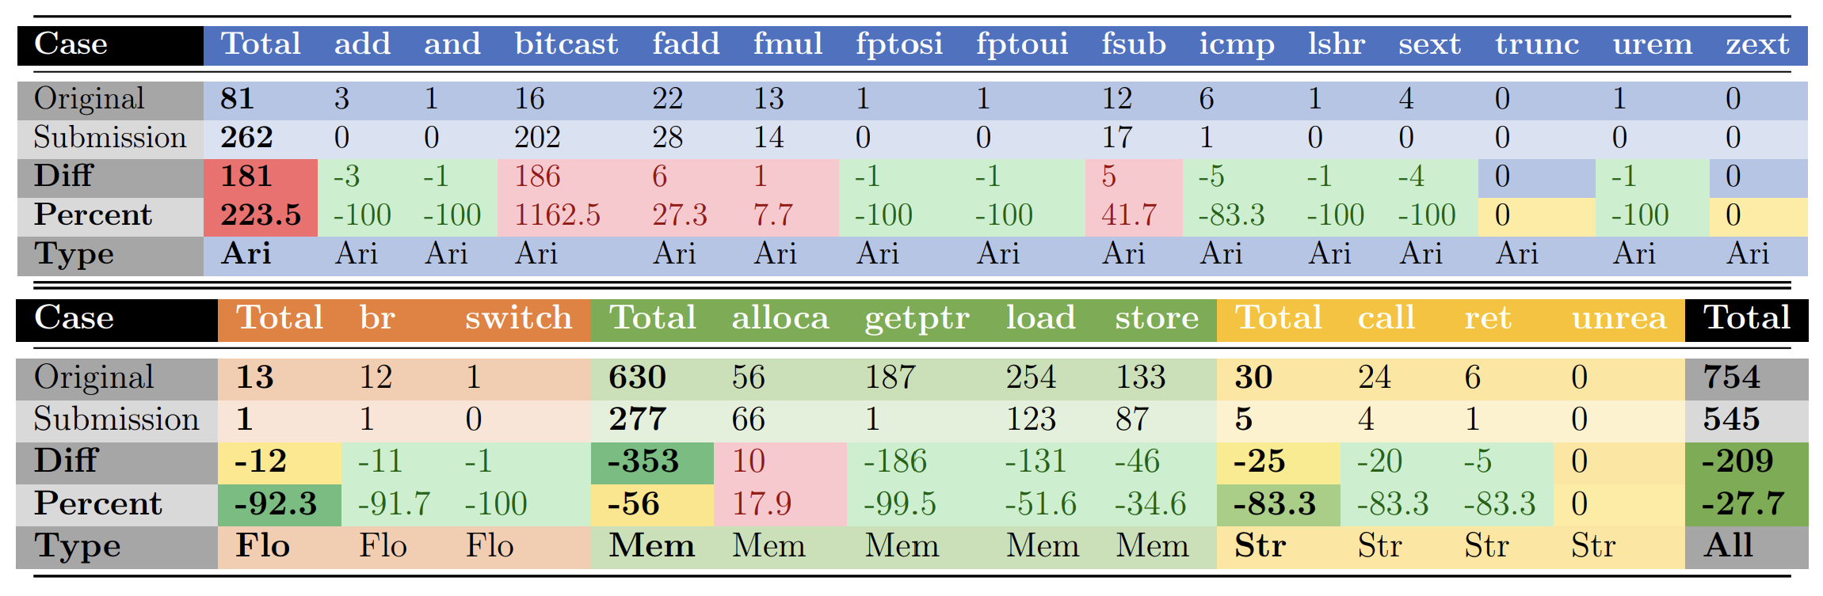
Grading Submissions
Functional equivalence
Symbolic execution
Random test cases
Code equivalence
Performance analysis
Control flow graphs
Code comprehension

Slide 67








Architecture
Endpoint Monitor
Back End
Accumulator
Aggregator
Receiver
Local Persistence
Websocket
Back End Persistence
JNativeHook
OSHI
Java
Annotater
Tomcat
Exporter
HTTP Requests
Visualization
Browser
Subject
Analyst

Slide 68
Relationships to Petri Nets
Petri nets can be generated from annotations
Requires inference and assumptions regarding annotation relationship meaning
These are not always accurate and are meant to capture the majority of cases
Where assumptions are wrong, the model can be manually corrected
After calculating relationships, applying these rules generates a Petri net

Slide 69
Hierarchical Relationships
Task 1: Parent
Task 2: Child
Task 2
[2]
Task 1
[2,1]

Slide 70
Sequential Relationships
Task 1: Parent
Task 2: Child
Task 3: Child
Task 2
[2]
Task 3
[2, 3]
Task 1
[2, 3, 1]

Slide 71
Multiple Predecessors
Task 1: Parent
Task 2: Child
Task 3: Child
Task 4: Child
Task 2
[2]
Task 3
[2, 4, 3]
Task 1
[2, 4, 3, 1]
Task 4
[4]

Slide 72
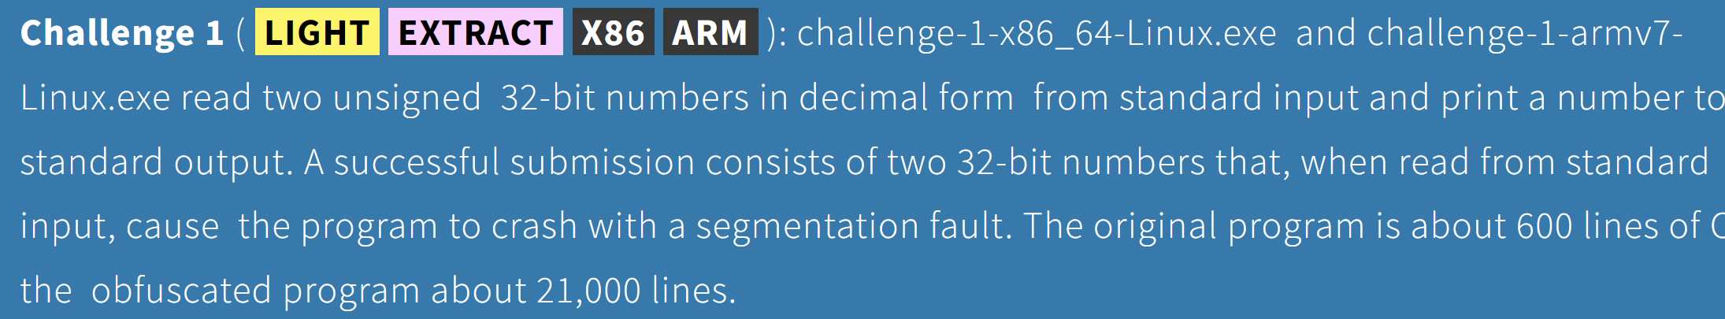
Examples

Slide 73
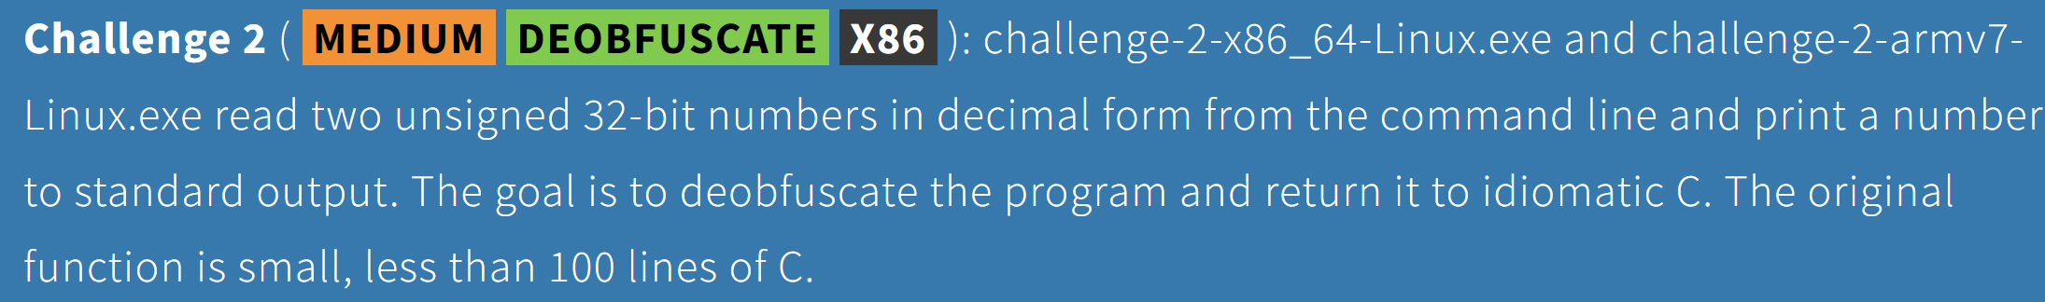
Examples

Slide 74
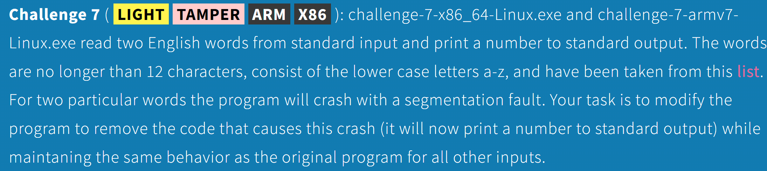
Examples

